Slide 1





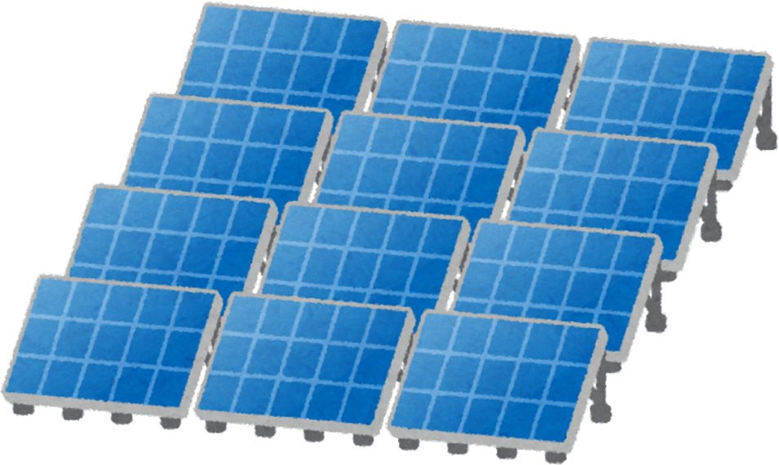

HOW GEOTHERMAL
&
HYDROTHERMAL ENERGY IS HARNESSED

Slide 2

SHORT ACTIVITY

Slide 3

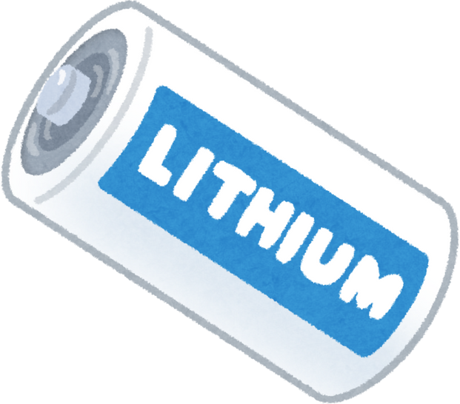
WHAT IS ENERGY?
Energy is the ability to do work or cause change. It can take many forms, such as kinetic energy from motion, potential energy stored in objects, thermal energy as heat, chemical energy in food or fuel, electrical energy from moving electrons, and light energy. Energy is present whenever something moves, changes, heats up, or produces light.

Slide 4
GEOTHERMAL ENERGY
Geothermal energy is the heat energy stored beneath the Earth's surface. It comes from the natural heat of the Earth’s core and can be used to generate electricity or provide direct heating. This energy is renewable and sustainable.

Slide 5
HOW GEOTHERMAL ENERGY IS HARNESSED
Geothermal energy is harnessed by drilling wells into hot water or steam reservoirs underground. The steam or hot water can turn turbines to generate electricity or be used to heat buildings, providing a renewable and sustainable energy source.

Slide 6
HYDROTHERMAL ENERGY
Hydrothermal energy is a type of geothermal energy that comes from hot water or steam trapped beneath the Earth's surface. This heat can be used to generate electricity or provide heating. It is harnessed by drilling wells into underground reservoirs of hot water or steam and directing it to turbines or heating systems.

Slide 7
HOW HYDROTHERMAL SYSTEMS PRODUCE ENERGY
Hydrothermal systems produce energy by using hot water or steam from underground reservoirs. The steam or hot water is brought to the surface through wells, where it turns turbines to generate electricity or provides direct heating. This process converts the Earth’s natural heat into usable energy.

Slide 8
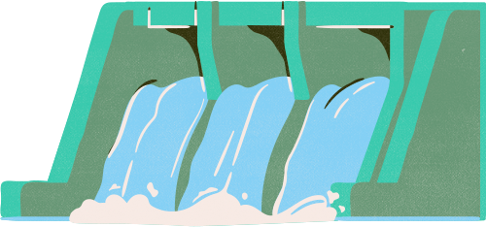
TYPES OF GEOTHERMAL POWER PLANTS
Dry Steam Plants – use steam directly from underground wells to turn turbines and generate electricity.
2. Flash Steam Plants – pull high-pressure hot water from the ground and convert it into steam to drive turbines.
3. Binary Cycle Plants – transfer heat from geothermal water to another fluid with a lower boiling point, which then vaporizes and turns turbines.

Slide 9
The benefits of geothermal and hydrothermal energy include:
Renewable and sustainable – the Earth constantly produces heat, making it a long-term energy source.
Environmentally friendly – produces very low greenhouse gas emissions compared to fossil fuels.
Reliable and consistent – unlike solar or wind, geothermal energy is available 24/7.
Cost-effective in the long term – after the initial setup, maintenance and operational costs are low.
Direct uses – can provide heating for homes, greenhouses, and industries.
BENEFITS OF GEOTHERMAL & HYDROTHERMAL ENERGY

Slide 10
CONCLUSION
Geothermal and hydrothermal energy are renewable sources of heat from beneath the Earth’s surface. They can be used to generate electricity or provide direct heating. These energy sources are environmentally friendly, reliable, and cost-effective, making them a sustainable alternative to fossil fuels.

Slide 11
REFERENCE LIST
U.S. Department of Energy. (n.d.). Geothermal Energy Basics. Retrieved https://www.energy.gov/eere/geothermal/geothermal-energy-basics
International Renewable Energy Agency (IRENA). (2021). Geothermal Energy. Retrieved f https://www.irena.org/geothermal
Geothermal Education Office. (n.d.). How Geothermal Energy Works. Retrieved https://www.geothermal.marin.org/how-geothermal-work
National Renewable Energy Laboratory (NREL). (2020). Types of Geothermal Power Plants. Retrieved https://www.nrel.gov/research/re-geothermal.html
World Energy Council. (2020). Hydrothermal Geothermal Energy. Retrieved
https://www.worldenergy.org/energy-resources/hydrothermal
Union of Concerned Scientists. (2018). Advantages and Challenges of Geothermal Energy. Retrieved https://www.ucsusa.org/resources/geothermal-energy

Slide 12
QUIZ TIME
4. Which type of geothermal plant uses steam directly from underground?
A. Dry Steam Plant
B. Flash Steam Plant
C. Binary Cycle Plant
D. Coal Plant
5. What type of geothermal plant converts hot water to steam before using it?
A. Dry Steam Plant
B. Flash Steam Plant
C. Binary Cycle Plant
D. Nuclear Plant
1. What is geothermal energy?
A. Energy from sunlight
B. Energy from moving water
C. Heat energy from beneath the Earth's surface
D. Energy from burning fuel
2. Which of these is an example of geothermal energy use?
A. Solar panels
B. Hot springs
C. Wind turbines
D. Coal power plant
3. What is hydrothermal energy?
A. Energy from ocean waves
B. Heat from underground hot water or steam
C. Energy from wind
D. Energy from fuel combustion

Slide 13
QUIZ TIME
9. Geothermal energy is considered:
A. Non-renewable
B. Renewable
C. Polluting
D. Unreliable
10. Hydrothermal energy is mainly harnessed through:
A. Wind turbines
B. Geothermal power plants
C. Solar panels
D. Coal power plants
6. What is a key benefit of geothermal energy?
A. It produces large amounts of greenhouse gases
B. It is renewable and sustainable
C. It only works during the day
D. It is non-renewable
7. Which type of geothermal plant uses a secondary fluid with a lower boiling point?
A. Dry Steam Plant
B. Flash Steam Plant
C. Binary Cycle Plant
D. Hydro Plant
8. Where is geothermal energy commonly used for heating?
A. Factories, homes, greenhouses
B. Deserts
C. Mountains only
D. Oceans

Slide 14
THANK YOU

